Slide 1

Flight Delay Analysis
Presented By: Team2
Anjaneya Kamepalli(akamepalli2@horizon.csueastbay.edu)
Fabjola Kasaj (fkasaj@horizon.csueastbay.edu)
Deepthi Mounica Mandalaparty (dmandalaparty@horizon.csueastbay.edu)
Under the Guidance of:
Dr. Chongqi Wu
^{6th} May,2022

Slide 2
Agenda:
Team:2
Introduction
Project Scope
Project Phases
Data collection
Data Pre-Processing
Tableau Analysis Dashboards
Website hosting
Technical challenges faced
Conclusion

Slide 3
Introduction:
Team:2
AIM: Flight delay analysis to help the future travelers in making wise decision by choosing right carrier and airports.
Background/Purpose: Time is invaluable in global playing field. Travel delay is becoming metric in defining service quality. In Air travelling customers don’t have the platform/information to decide upon which carrier is best for them based on their diversified priorities. Our project is building a web interface for customers based on the true history of different carrier performance in past 10years. This website providing the graphical interface for different carriers and airports, by that users can avoid the predictable delays in their travel.

Slide 4
Project Scope:
Team:2
The scope of our project analysis is confined to the research questions described at the project planning phase.
Gathering the flight delay data from trusted source and preprocessing it.
Running map reduce Jobs to process the data and create the dataset for analytics
Building the Tableau dashboards for graphical representation of analysis
Building a website to provide user interface to interact with the dashboards
Departure Delay Vs Origin Airport; Arrival Delay Vs Origin Airport; Temporal Variability of Delays
Monthly Delay Trends & Reasons ; Carrier Arrival and Departure Delays
Carrier Vs National air system(Nas) Delay
Analyzing the Ripple effect, to determine the Probabilistic prediction of delays for each carrier.
Analyzing the average delay by origin city there by calculating the probability of carrier gets delayed or Probability of carrier to be on-time.
Analyzing the delay based on the Wheels_on_Time in correlation with distance groups and Airtime.

Slide 5
Project Phases:
Team:2
Data Cleaning
Map Reduce
Data Visualization
Building Web Interface
Data Reframing

Slide 6
Data Collection:
Team:2
Data is the backbone of Analytics; we should choose the trusted sources to collect data before to start working on project.
To collect the Flight Delay data, we have relied on the government website https://www.transtats.bts.gov/OT_Delay/OT_DelayCause1.asp?20=E
This data consists of domestic US flights reported to the United States Bureau of Transportation Statistics
We have downloaded last 10 years of data starting from 2010 to 2020
This is a huge dataset with 11,221,080 rows and 52 columns.
Filling factor almost 100%.

Slide 7





Dataset Overview:
Team:2
OP_UNIQUE_CARRIER: Unique Carrier Code.
ORIGIN_AIRPORT_ID: Origin Airport, Airport ID.
ORIGIN_STATE_NM: Origin Airport, State Name.
ARR_DELAY: Difference in minutes between scheduled and actual arrival time.
DEP_DELAY: Difference in minutes between scheduled and actual departure time.
BTS
The Bureau of Transportation Statistics

Slide 8
Data Pre-Processing:
Team:2
Dataset cleaning carried out by using python code
Dropping the rows with missing values
Dropping the unwanted columns from dataset
Running the Hadoop Map reduce jobs to preprocess the data
Creating the final version of cleaned dataset for all the years

Slide 9
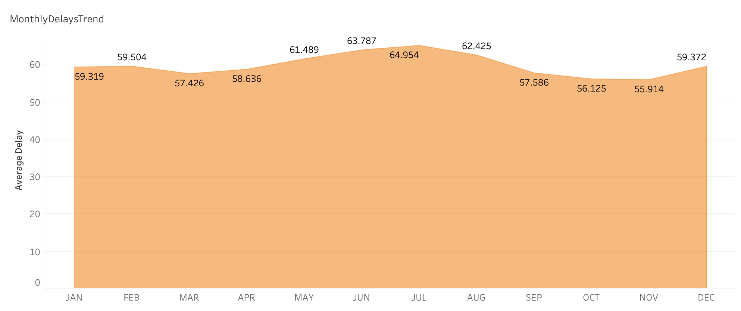
Monthly Delay Trends:
Team:2
July
The monthly average arrival delay for July is highest with 64.9 minutes and the monthly average arrival delay for November is the least with an average of 55.9 minutes ,compared to all the 12 months.
November
Hence November is the best time to travel and we can expect delays for sure in the month of July.
November, October, September and March
are the top preferred months to travel with least average delays.

Slide 10
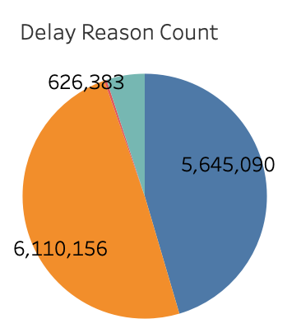
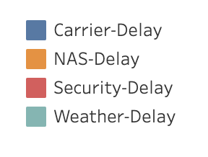
Flight Delay Reasons:
Team:2
NAS-Delay contributes more when compared to all the other reasons of delays in the below pie-chart with almost 50% occupancy.
Hence it is the most frequent reason for flight delays.
Carrier-Delays are the second most frequent reasons for delays.
Security-Delays contributes almost negligible count when compared to all the four reasons of delays.

Slide 11
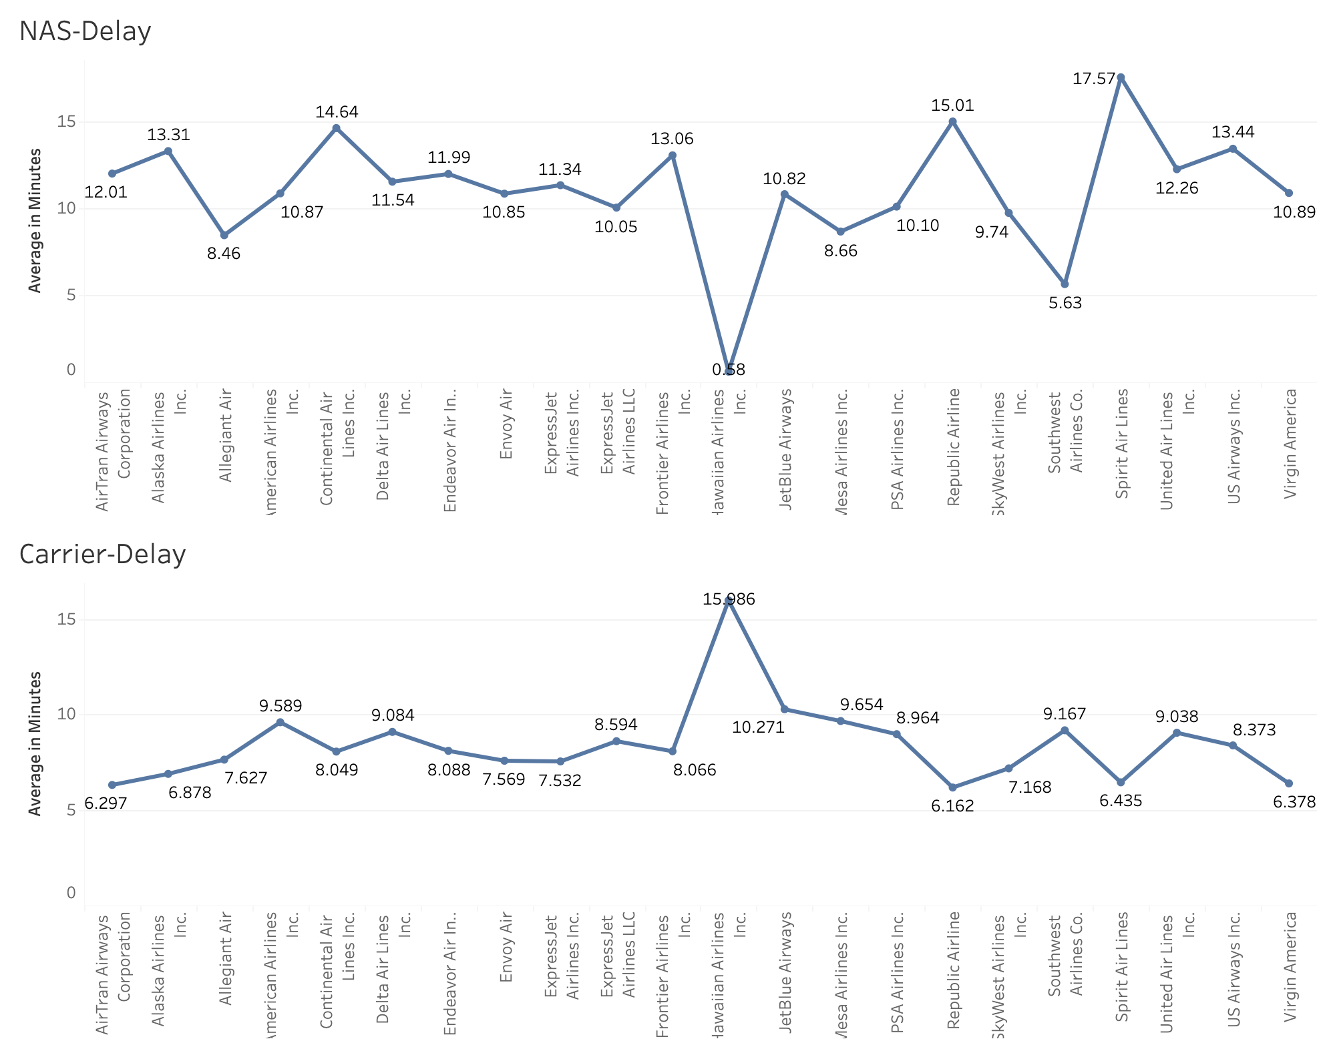
Carrier Vs NAS Delay:
Team:2
As NAS-delay and carrier delay contribute more towards the delays in airlines, the averages of the NAS delay and carrier delay per airline carrier is calculated in minutes.
The Hawaiian airlines which has the least average delay in both arrival and departure delays has high carrier-delay and spirit airlines has the highest average for the NAS-delay.

Slide 12
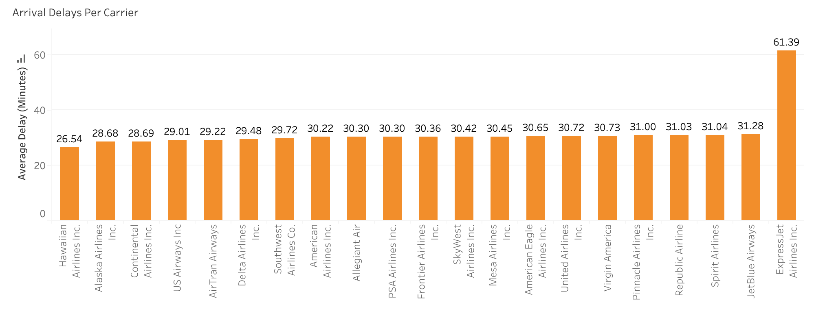
Average Arrival Delays Per Carrier:
Team:2
Hawaiian Airlines has the least average arrival delay of 26.5 minutes for the past 10 years of data when compared to all other airlines.
ExpressJet Airlines has the highest average arrival delay of 61.3 minutes when compared to all other airlines.
Almost all the other airlines excluding the above mentioned airlines have an average arrival delay of approximately 30 minutes.

Slide 13
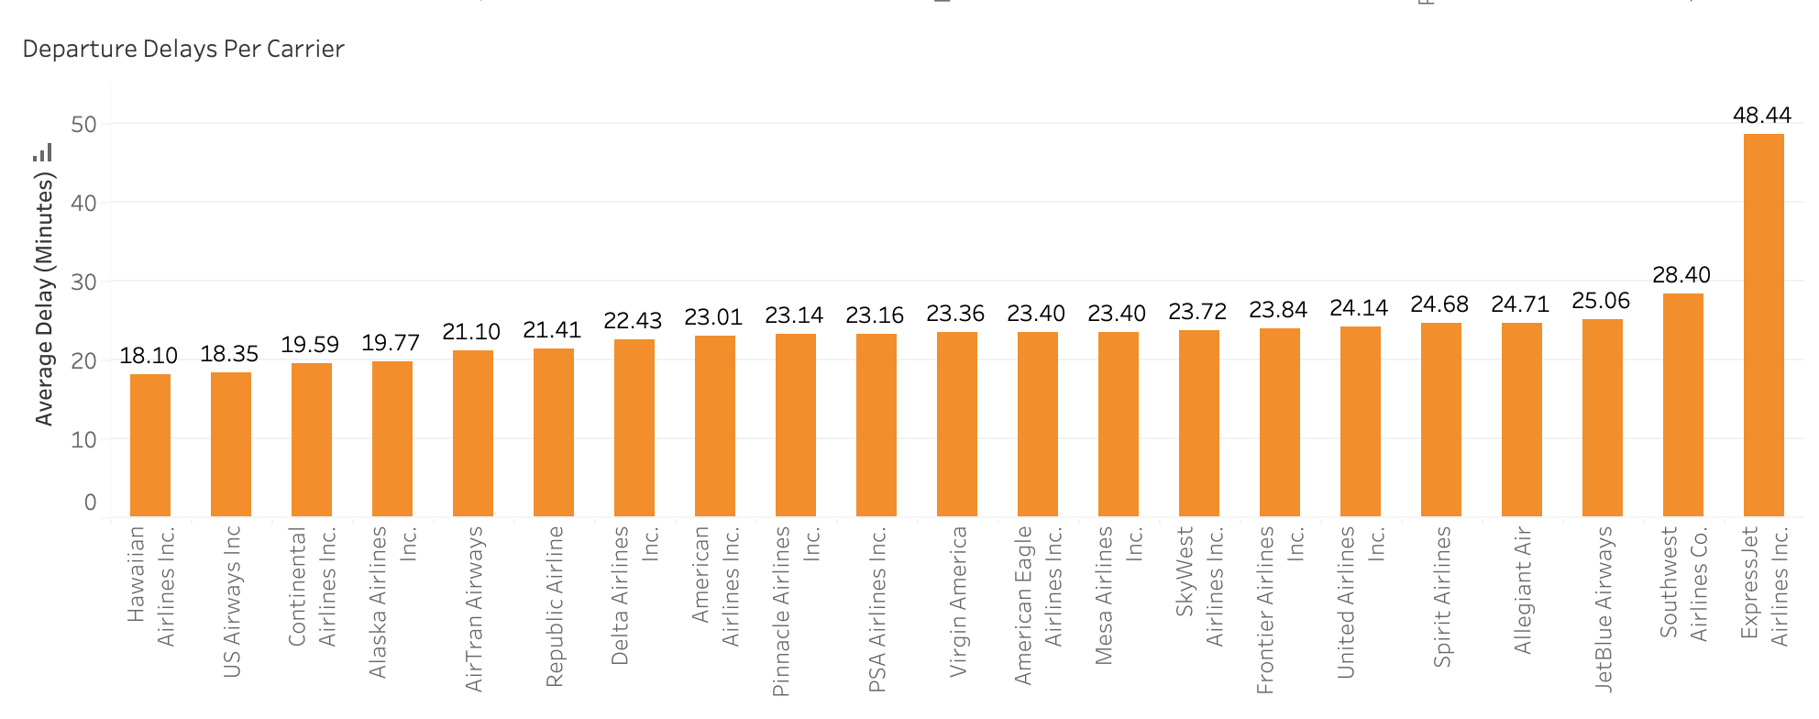
Average Departure Delay per Carrier:
Team:2
Hawaiian Airlines has the least average departure delay of 18.10 minutes.
ExpressJet Airlines has the highest average departure delay of 48.4 minutes for the past 10 years of data.
Almost all the other airlines have an average delay of approximately 20 minutes.

Slide 14
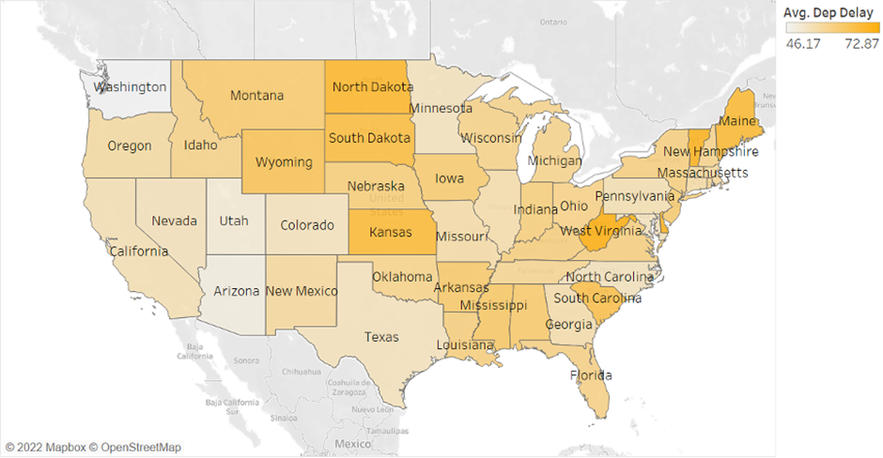
Mean Departure delay by airport:
Team:2
The departure delays vary from 46.17 to 72.87 minutes in average. The states with higher arrival delays are North Dakota, South Dakota and Kansas. While states with lower arrival delays are Arizona and Utah.

Slide 15
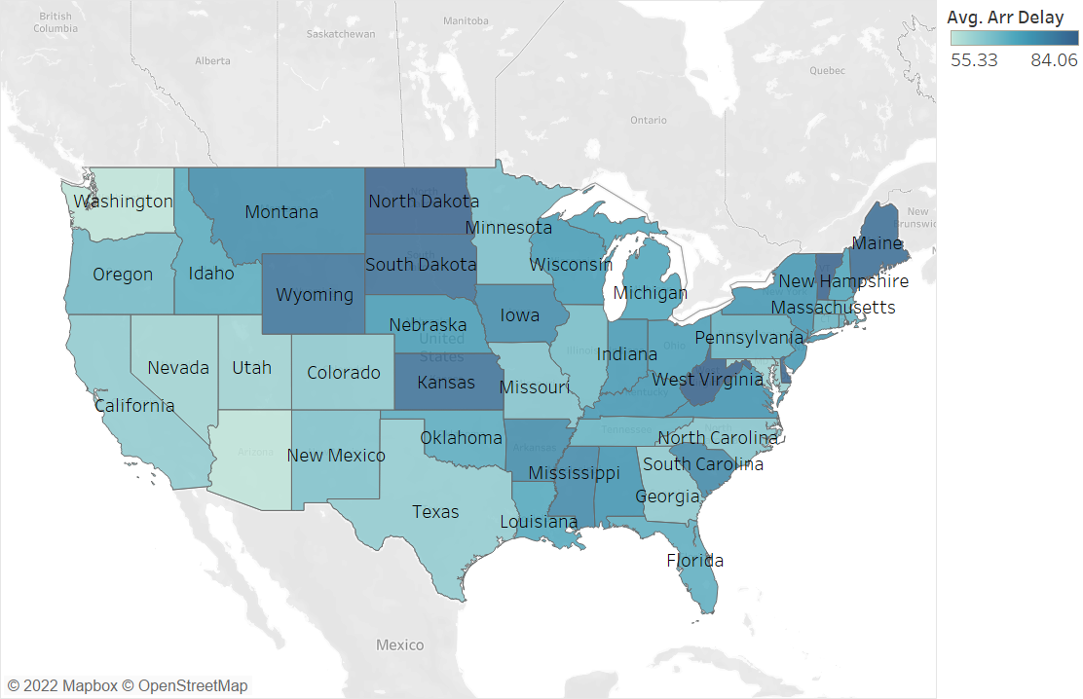
Mean Arrival delay by airport:
Team:2
The interval of arrival delays is 51.19 to 82.89 minutes in average. So, arrival delays seem to be longer departure ones. And the states with higher arrival delays are West Virginia, Kansas and North Dakota.

Slide 16
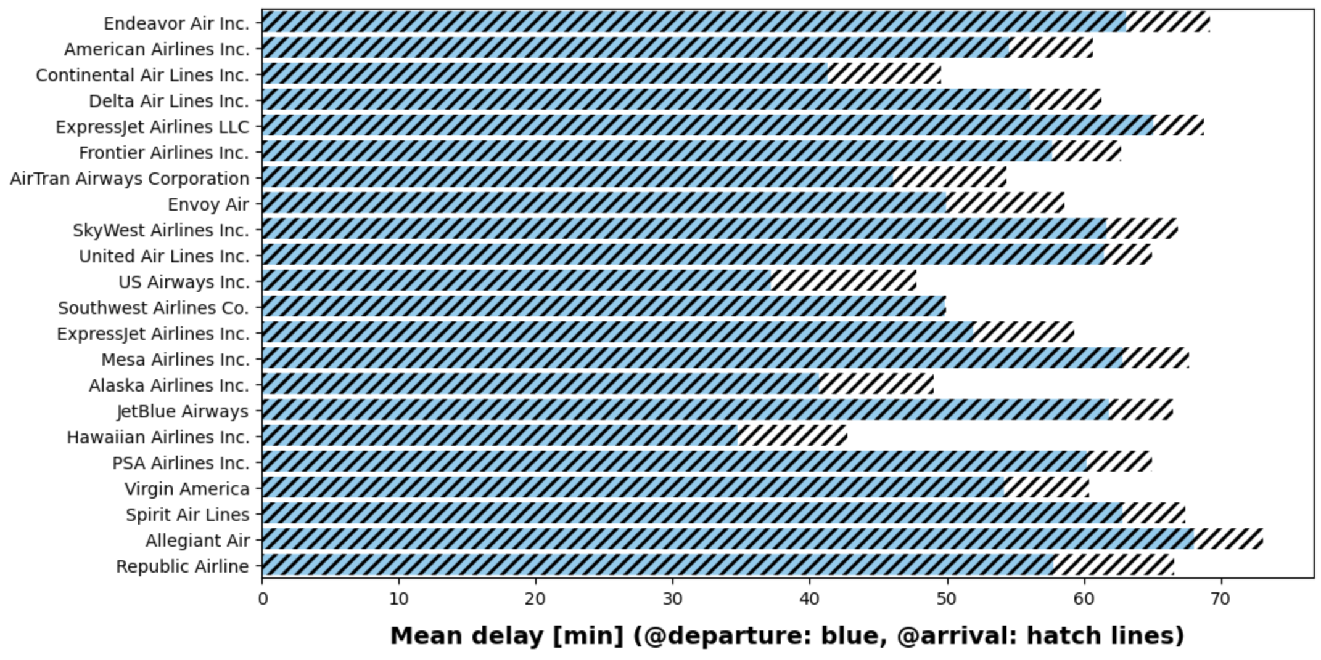
Take-off Vs Landing Delays:
Team:2
Delays at arrival are generally lower than at departure. This indicates that airlines adjust their flight speed in order to reduce the delays at arrival.

Slide 17
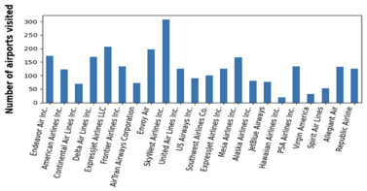
Count of Airports Visited by Carrier:
Team:2
In total we have 389 different airports in our dataset. Based on that, the graph shows the distribution of flights every airline company took in those airports.
From this graph we can notice that SkyWest Airlines, ExpressJet Airlines and Endeavor Air are the three companies with the largest flight numbers within the last 10 years.

Slide 18
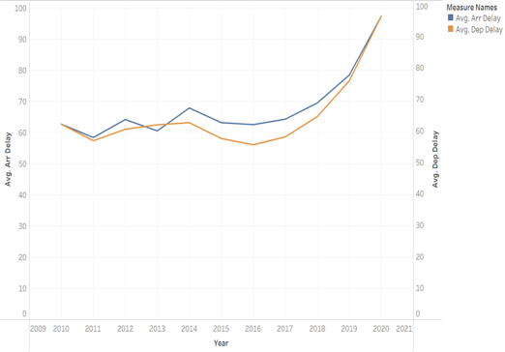
Line graph Arrival Vs Departure Delay:
Team:2
Observing the results overall there is a general tendency of having higher average arrival delays than departure delays in most of the cases.

Slide 19
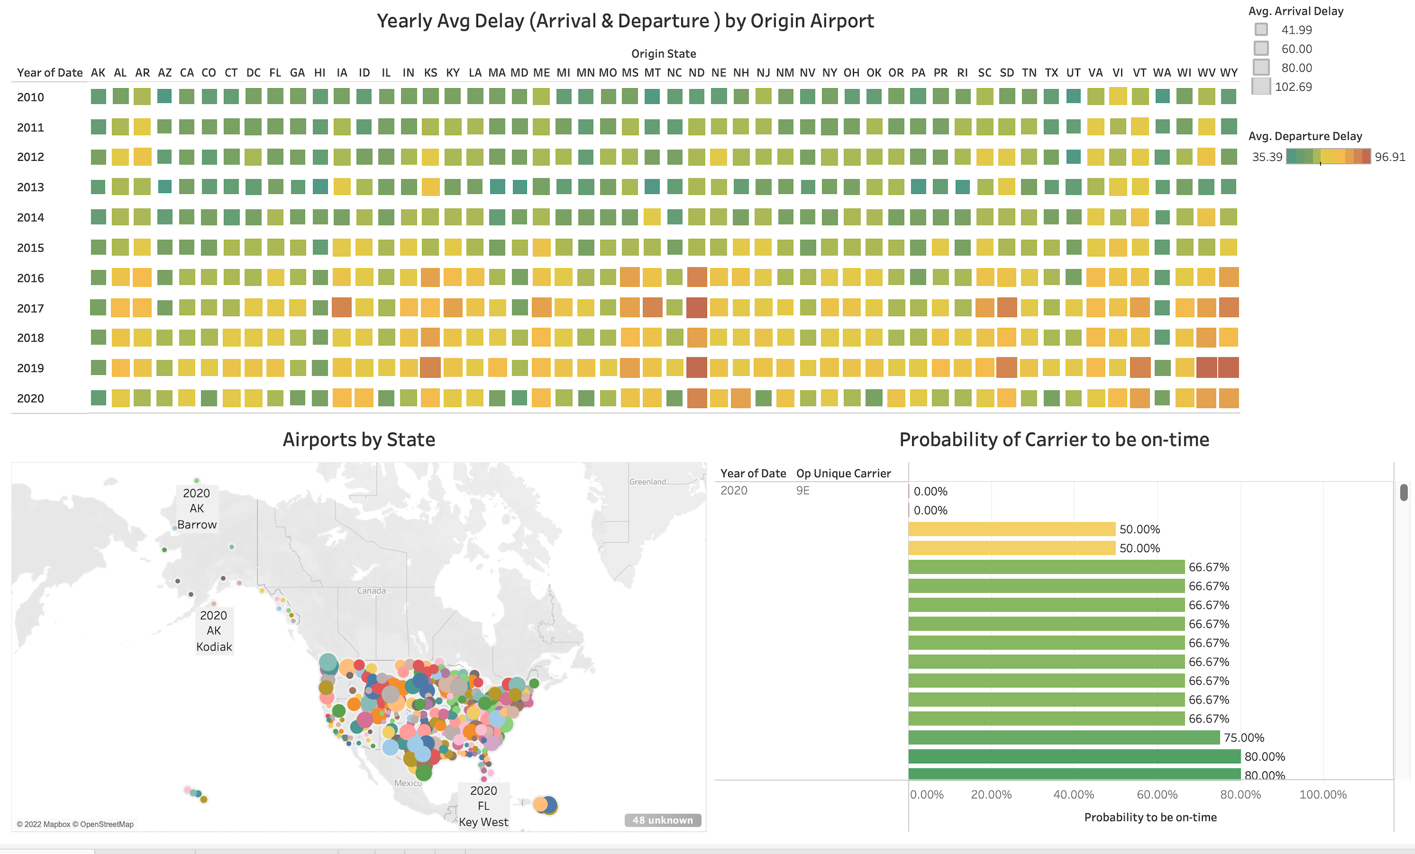
Interactive Data Visualization:
Team:2
Notes:
Thank you Deepthi,
Till now we have seen the static dashboards,
As Fabjola Explained at the beginning, we are building user interactive website. For that we have built the Multilevel Dashboards.
Multilevel dashboards means, it will provide the dynamic analysis based on the user selection from the website.
If we look at the heat map, rows are representing the year , and columns are representing states. Where as sizes of square-area representing the ‘Arrival delay’ as showing in the legend, and color of square representing ‘Departure delay’
Once user selects the state from where he wants to travel, he is presented with the airports in that state, by making selection from one of the airport, user can easily understand the on-time probability of different carrier. So that he can choose the best carrier as per his needs.
We will show the web interface , and how user experience is going to be in few mins..
Moving on to the next slide

Slide 20
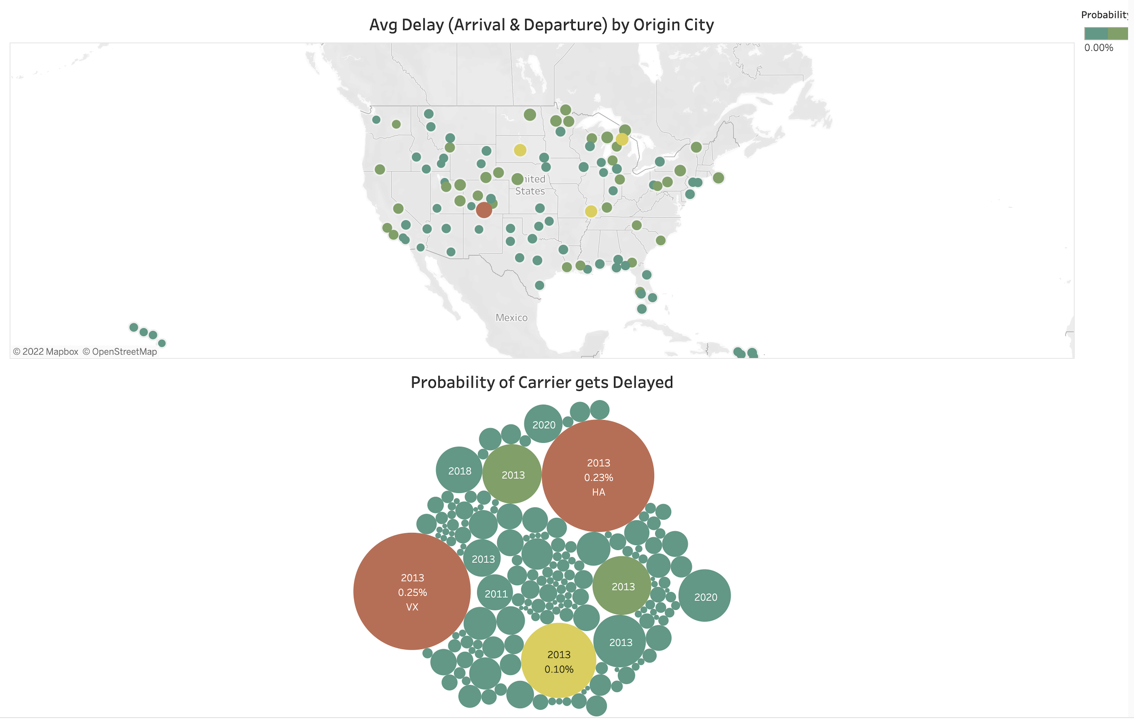
Interactive Data Visualization:
Team:2
Notes:
Dashboard 2 is the another visual representation of previous dashboard.. But in this we are going to see the probability of delay based on Origin city.
By choosing the city where user is going to travel he is presented with the probability of delay by each carrier..
Moving on to the next slide

Slide 21
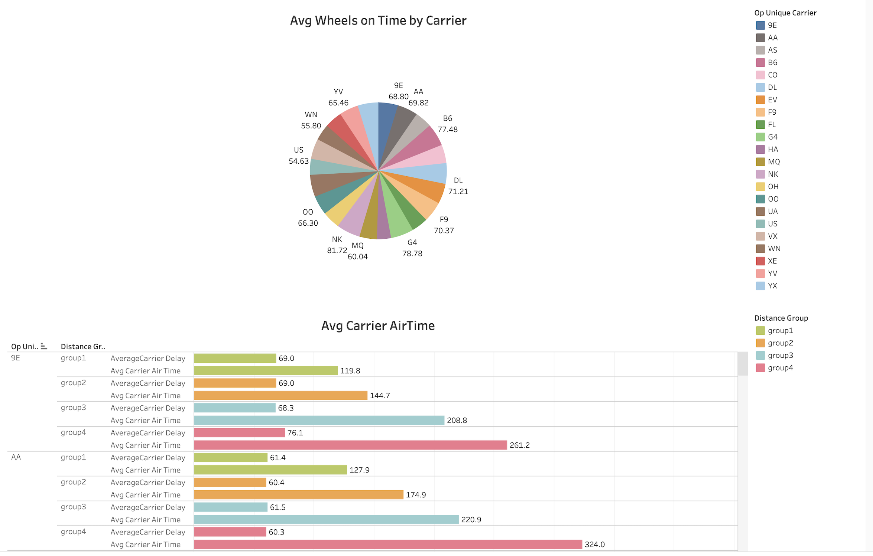
Interactive Data Visualization:
Team:2
Notes:
As we know time is inversely proportional to the distance, there will be more air time for longer distance travels.. So, viewing our analysis irrespective of distance is not fair..
So, we have provided analysis based on distance groups. As our dataset having Distance of flights in range upto 1800 miles.. We have divided our dataset into 4 groups..
Group 1 is in the range of 0-300 miles
Group 2 in the range of 300 -600 miles
Group3 in the range of 600 – 900miles
Group 4 in the range of 900 -1800 miles
We have very less flights over the range of 1200 miles, so grouped with the last group set.
If we look at the pie chart, we can select the carrier we want to see the performance, without any selection level2 is showing results for all the carriers..
IF we observe the level 2 , we are presenting the horizontal bar graphs, interestingly, all the carriers with the distance group 1 are having similar delay around (60 -70 mins),
Where as airtime is proportional to the distance group.
We will see interactive visualization in few mins..
Moving to the next slide…

Slide 22
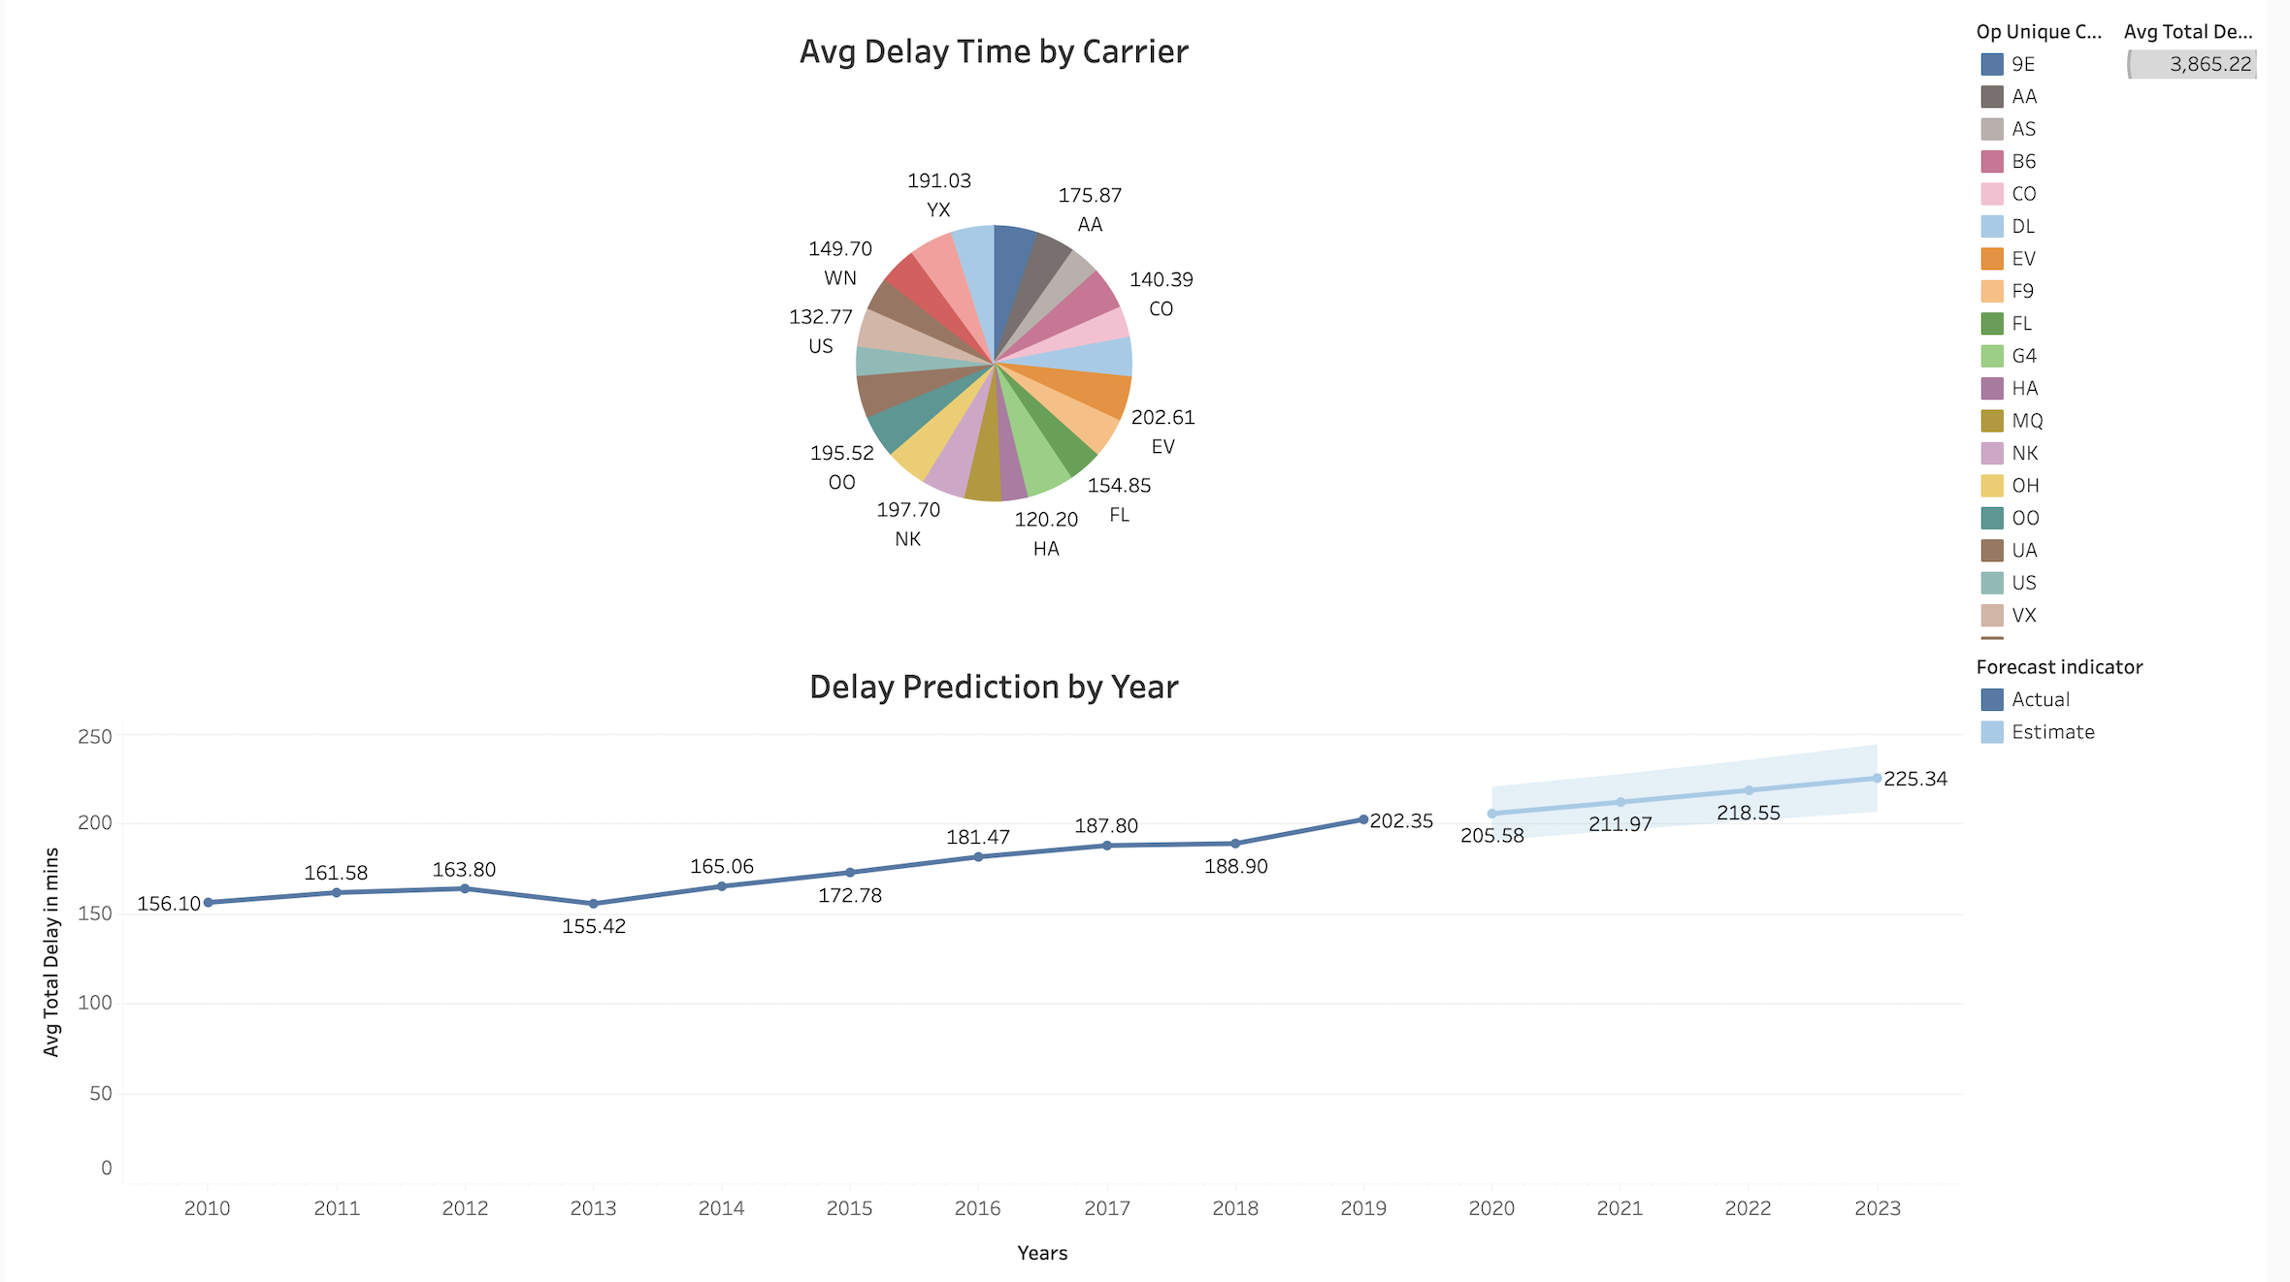
Interactive Data Visualization:
Team:2
Notes:
This dashboard representing the forecasting of delay by carrier..
We are using the piechart to select the carrier [ OO, UA, WN, EV] , the line chart representing the year wise average delay , y axis representing the ‘Average Total Delay in Mins’ .
The line plot is extended into the future which is showing the predicted delay in minutes.
Lets move on to next slide, to see how the dashboards embeded in website..

Slide 23
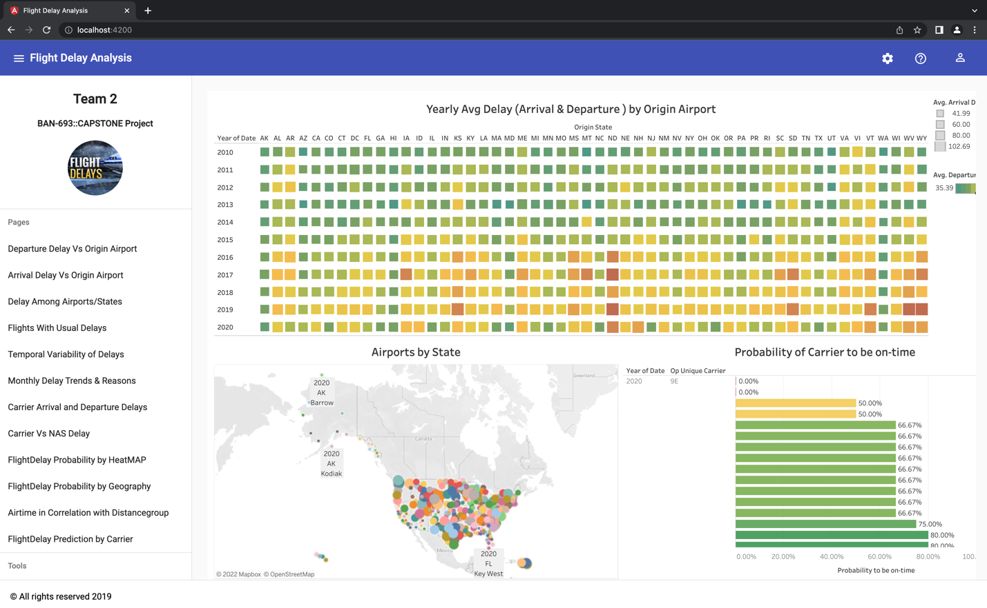
Website Hosting:
Team:2
GitHub URL: https://github.com/DeepthiMounica/FlightDelayAnalysis
Notes:
This is the website we have built for customer interface.. We can do more sophisticated way while hosting to a domain..
We built the website by using the Angular JS and HTML..
For version controlling, we have used GitHub, you can find the URL mentioned here.
Lets have a Quick tour to the webinterface…

Slide 24
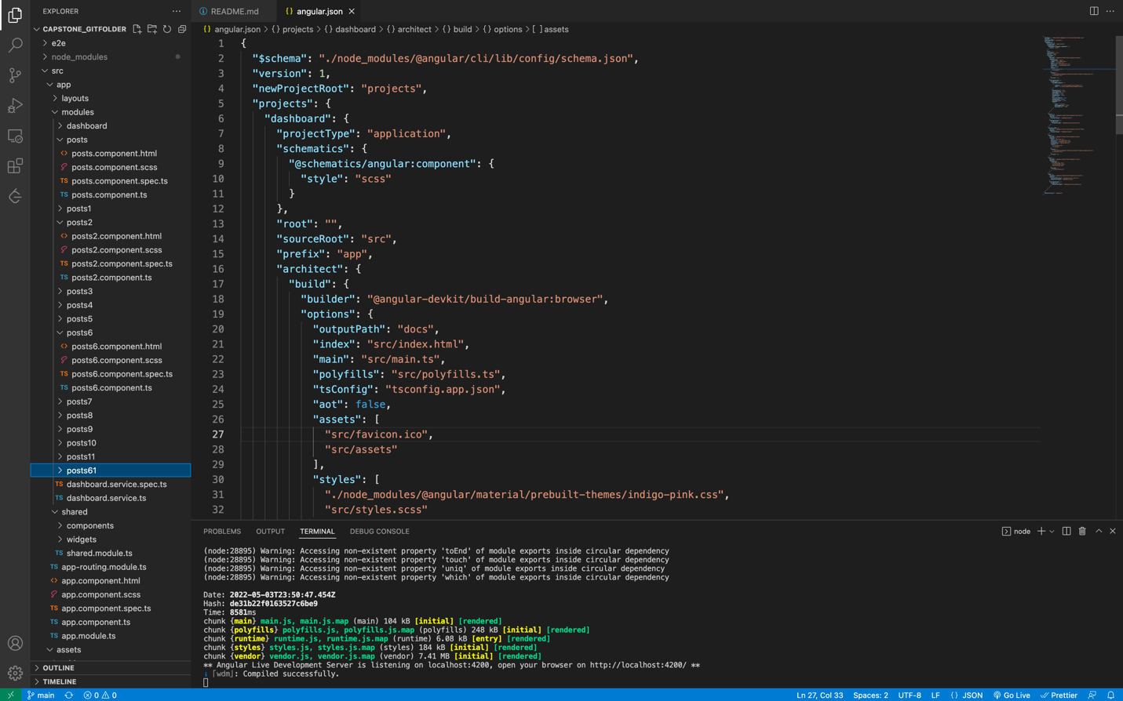
UI Project Structure:
Team:2
GitHub URL: https://github.com/DeepthiMounica/FlightDelayAnalysis
Notes:
This is the project structure we used in our website building…
Project folder contains the node modules, which are pre setup by using the ‘Angular-material’ library
Src is the folder where the source code of our project is
Layouts folder consists ,selecting the framework for our website page
Inside the modules , we built the posts HTML and linking to the page by using Iframe..
Moving on to the next slide..

Slide 25
Technical Challenges faced:
Team:2
Building the multilevel Dashboards in Tableau occupied extended time in stringent deadlines.
Working on website design and embedding dashboards in website are time taking tasks. For coding, testing, and debugging activities.
Installing single node Hadoop cluster in personal laptop and configuring
Notes:
Throughout the project we have overcomed some challenges…
Few of them are : During these 3 months, we spent considerable amount of time for building the ‘Multilevel Dashboards in Tableau’ with stringent deadlines..
Second point, ____________________________
In the beginning stage of our porject, we face challenging situation in configuring the single node Hadoop cluster in our personal laptops…
Ya moving on to the conclusion part in next slide,

Slide 26
Conclusion:
Team:2
Our Analysis on Flight delays as shown in the graphical interactive interface, user can quickly gain the knowledge about expected delays for desired origin and destination airports for Different carriers, there by making the wise choice in selecting carrier that have highest probability to be on time.
This analysis is available in UI website and made available in Git repository for hosting website upon project approval.

Slide 27
Open To The Floor:
Any Queries ?

